Slide 1
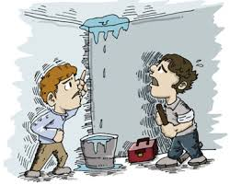
漏水修補技術

Slide 2
1.1 屋宇工程防水系統簡介
屋宇工程滲漏的成因
a. Design 設計
- Error (detail problem, copy)
Scope (coverage)
- Negligence 忽略
- Limitation 限制

Slide 3
b. Workmanship 手工
- Poor
- Training & knowledge
(C.P. Competent Person)
prequalification
- Time 時間
- Condition 條件 (wet & dry, windy, humid)
c. Structural 結構
d. Defects 損壞 / Aging 老化 (creep, damage)

Slide 4
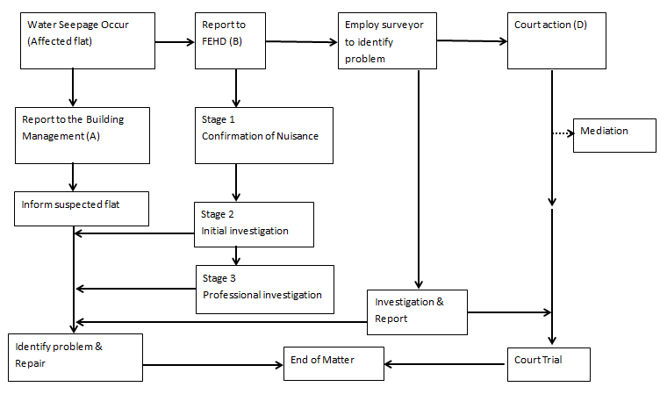
香港屋宇漏水一般的處理流程方法

Slide 5
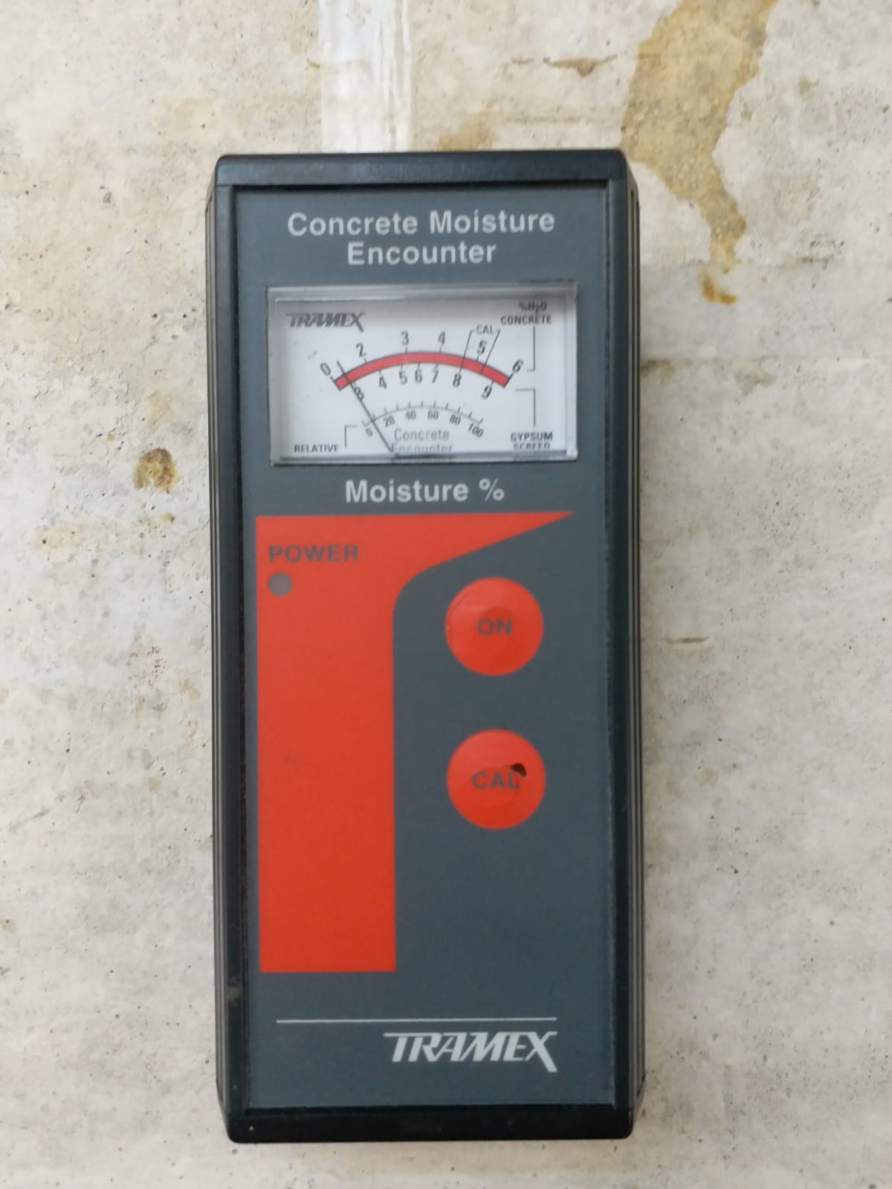
Moisture Meter

Slide 6
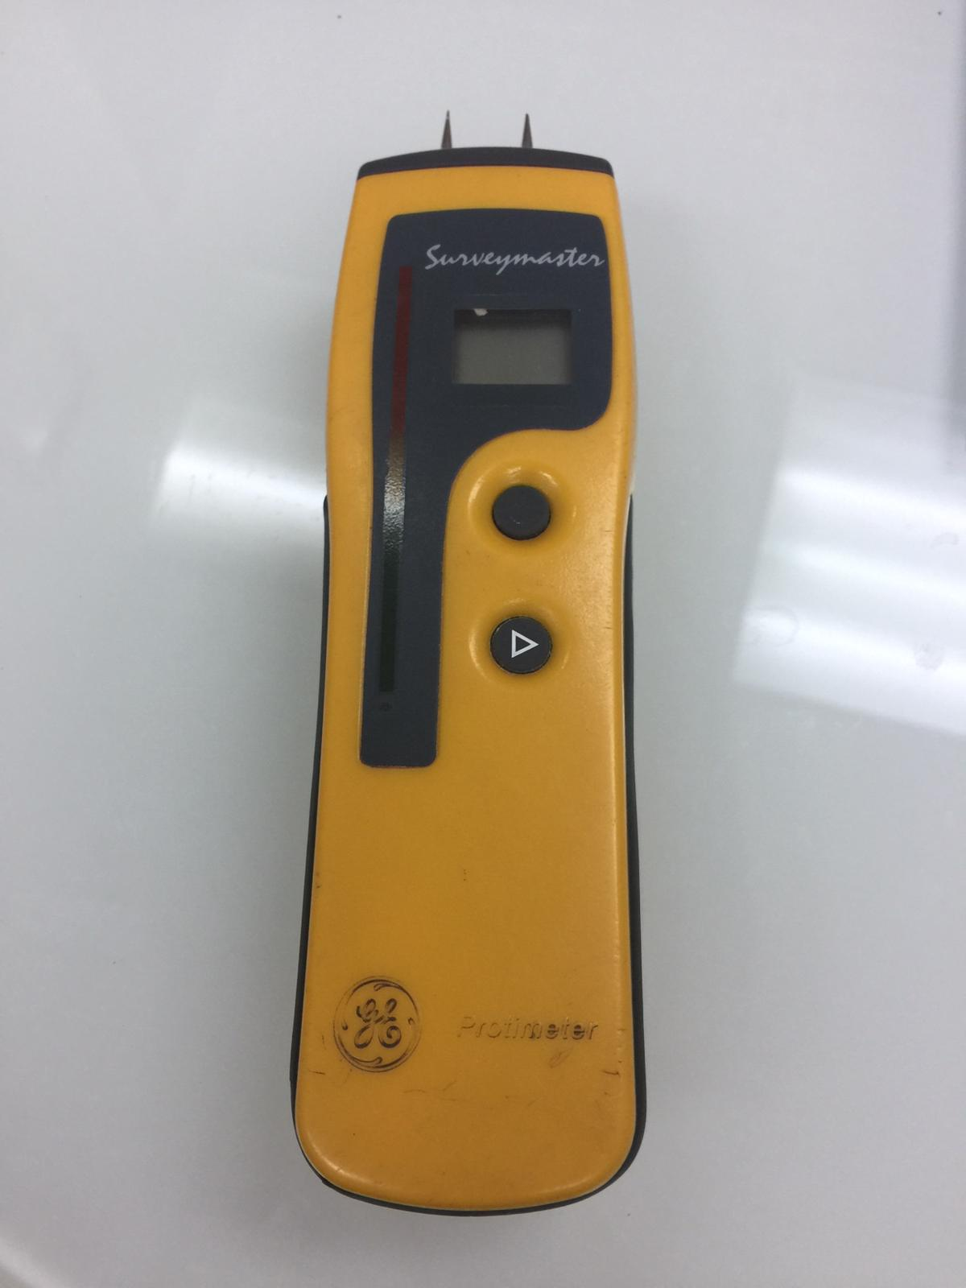
Protimeter

Slide 7
政府部門及條例所賦予的權力
Public Health and municipal Services Ordinances, Cap. 132 (“PHMSO”), section 127 of which confers on FEHD the power to issue nuisance notices;
Buildings Ordinance, Cap 123 (“BO”), which confers on BD power to issue orders requiring owner to demolish unauthorized building works (section 24), to make safe dangerous building (section 26), to investigate and remedy building defects (section 26A), and to investigate and remedy drainage defects (section 28’) and
Waterworks Ordinance, Cap 102 (“WO”), section 16 of which confers requiring repairs in case of wastage of water.)

Slide 8
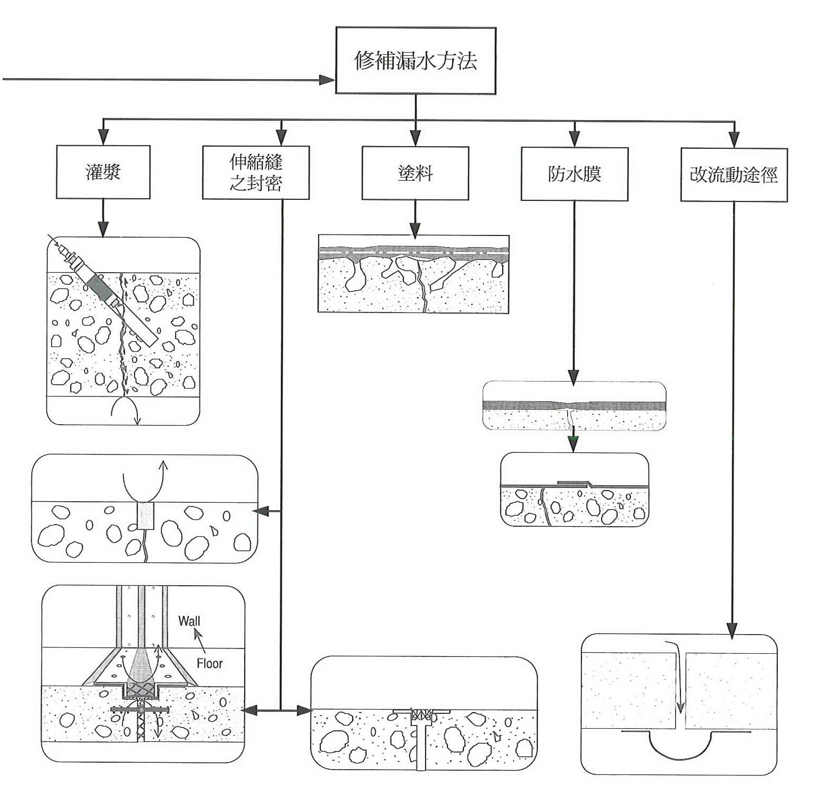
補漏方法

Slide 9
補漏水效果最基本要求
找出正確有效的方法之外
真正水眼位置
漏水原因
足夠工作空間

Slide 10
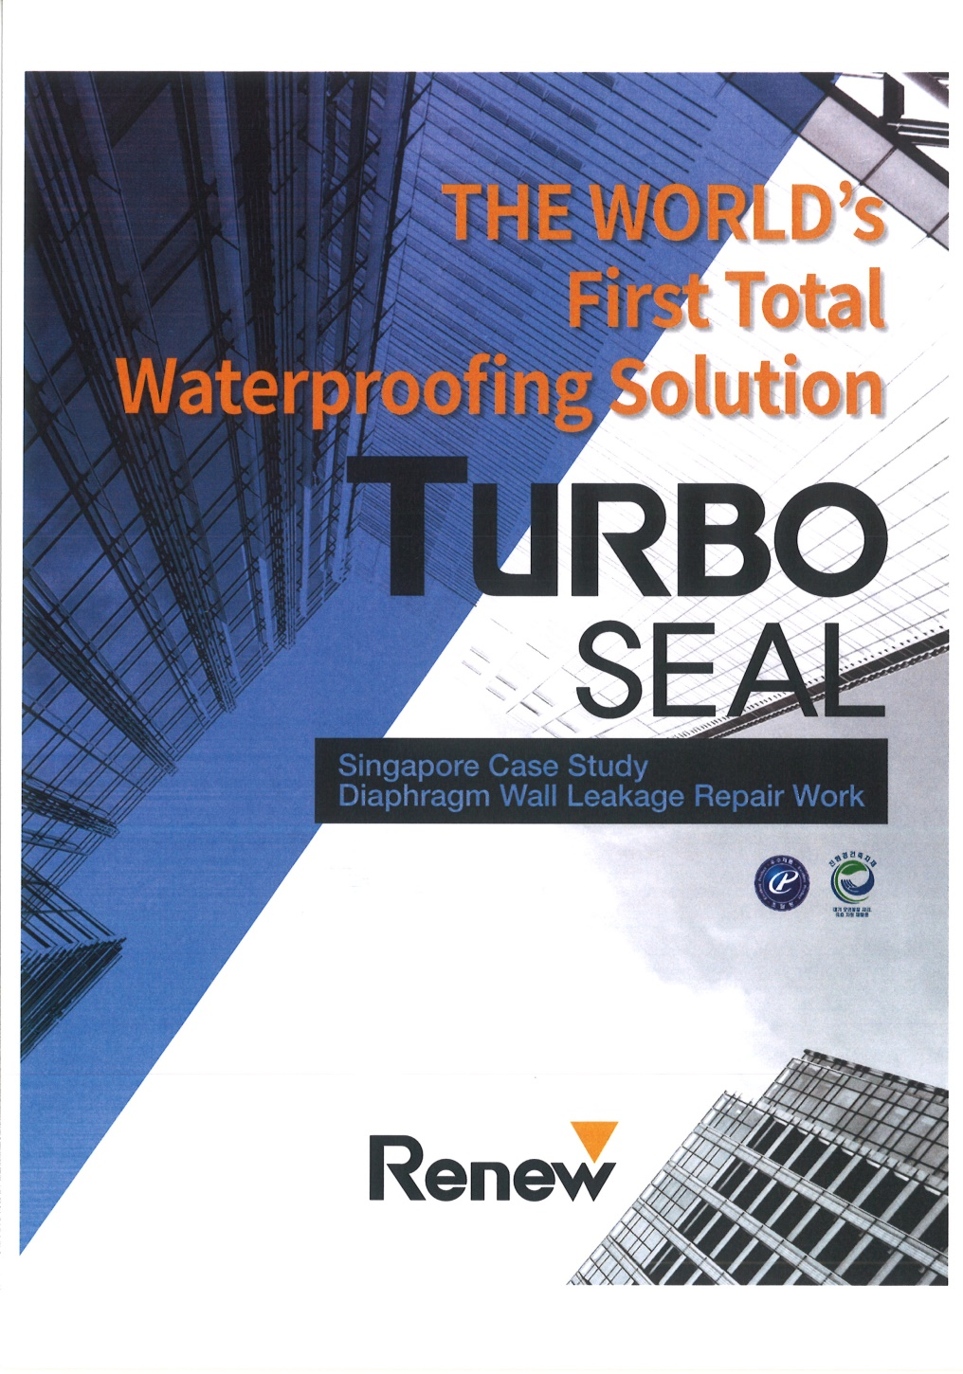
Case Study I
Turbo Seal

Slide 11
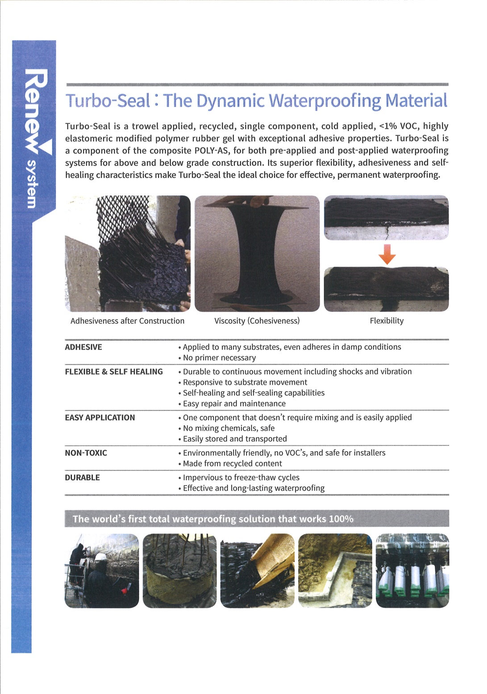

Slide 12
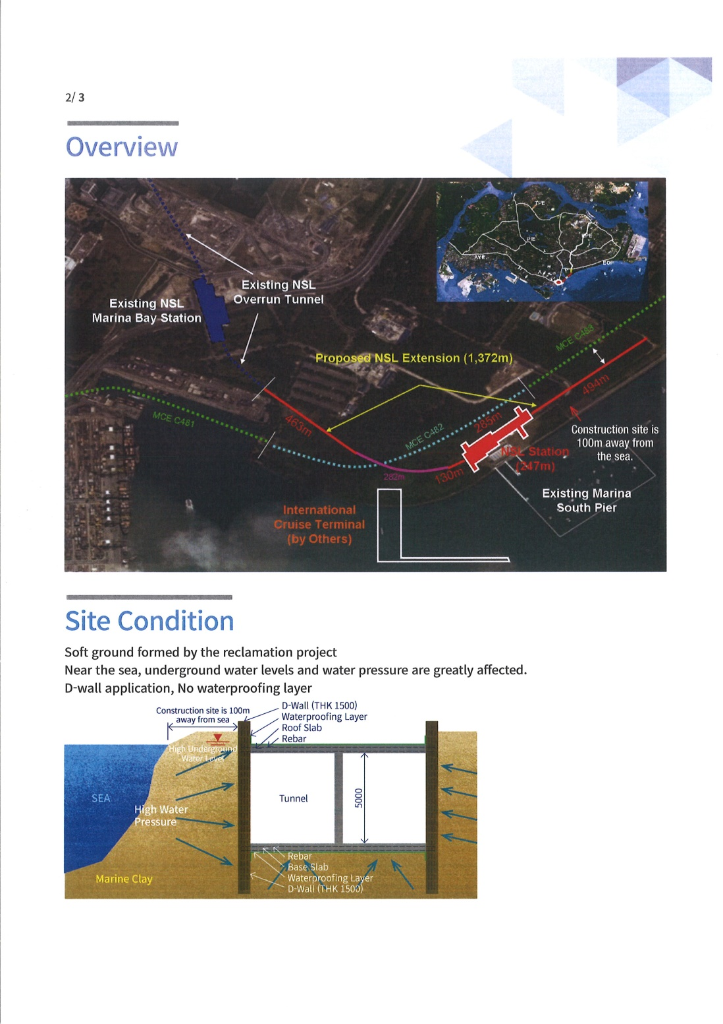

Slide 13
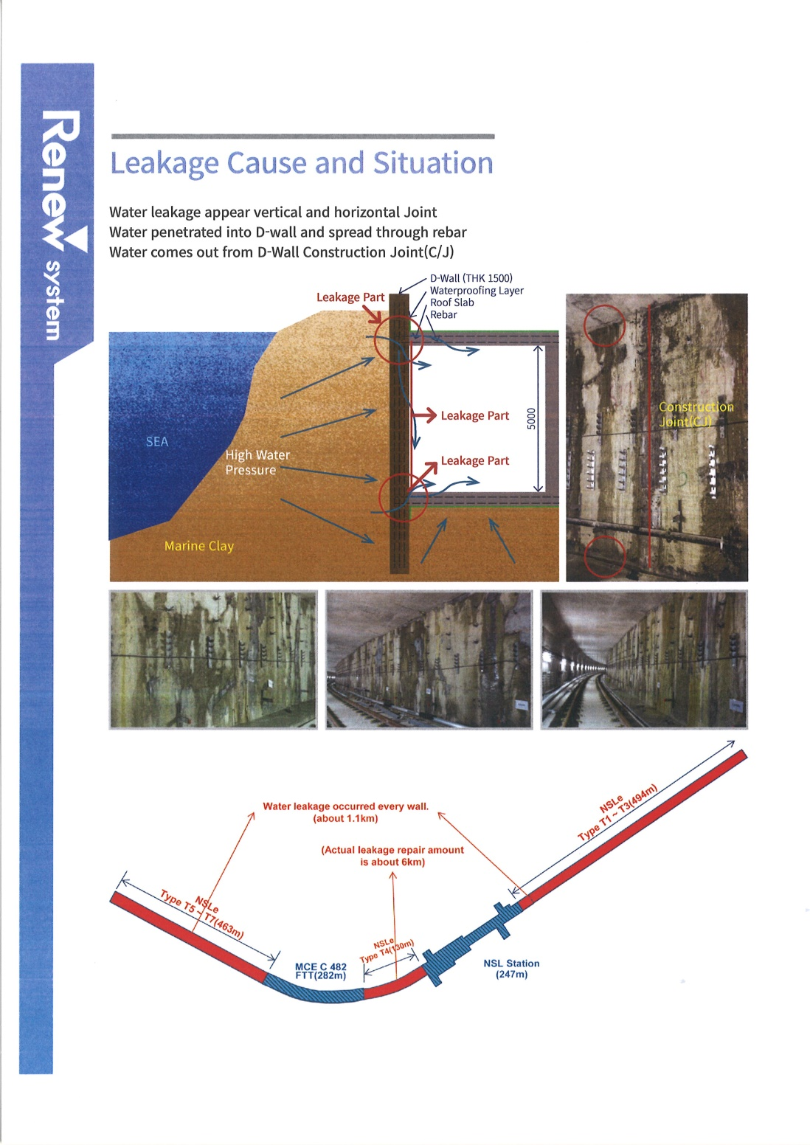

Slide 14
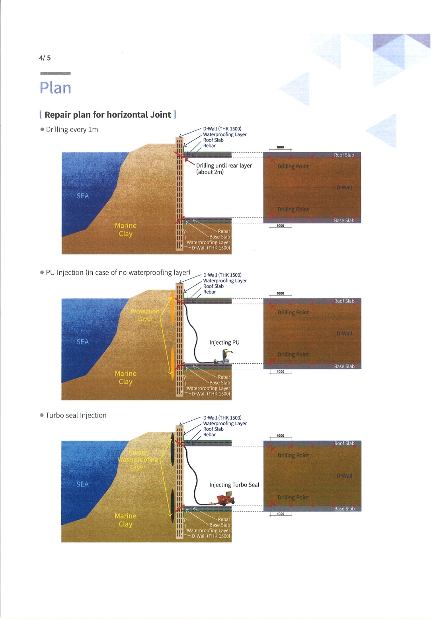

Slide 15
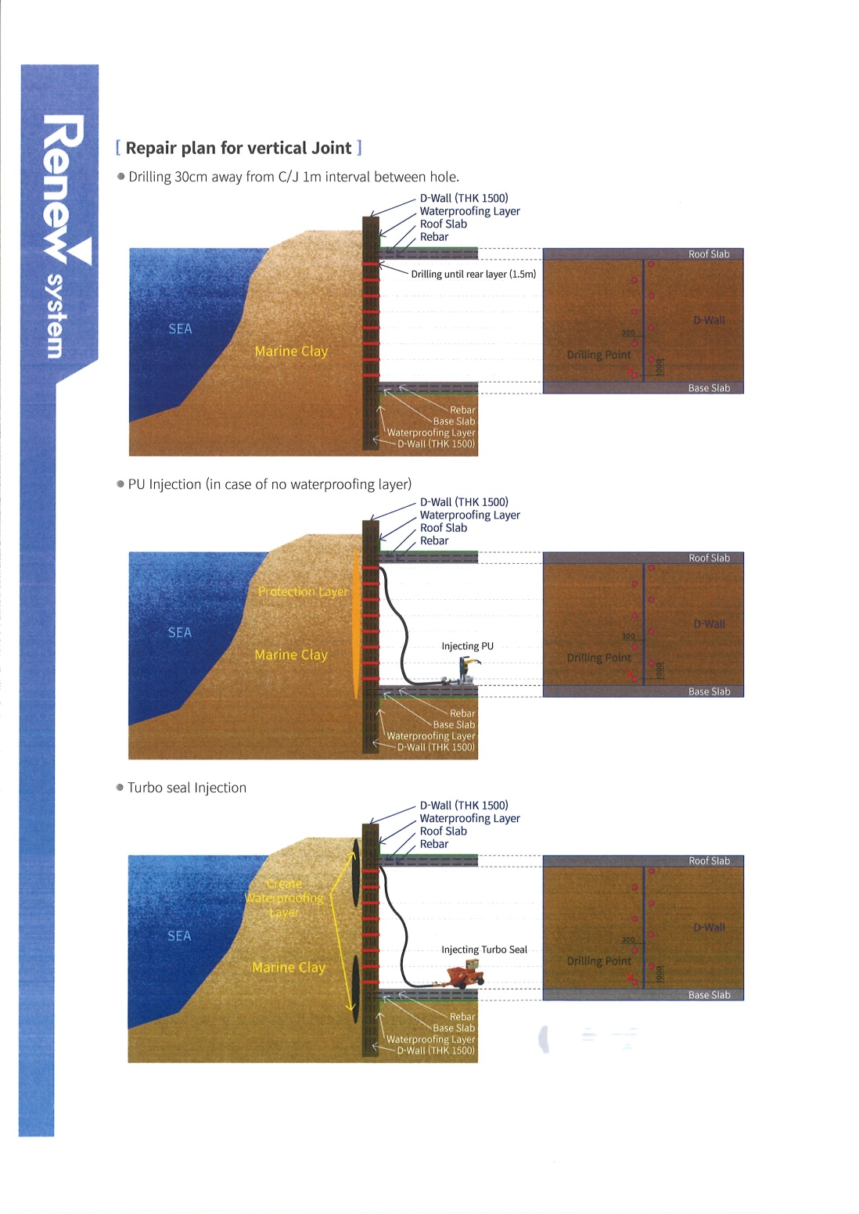

Slide 16
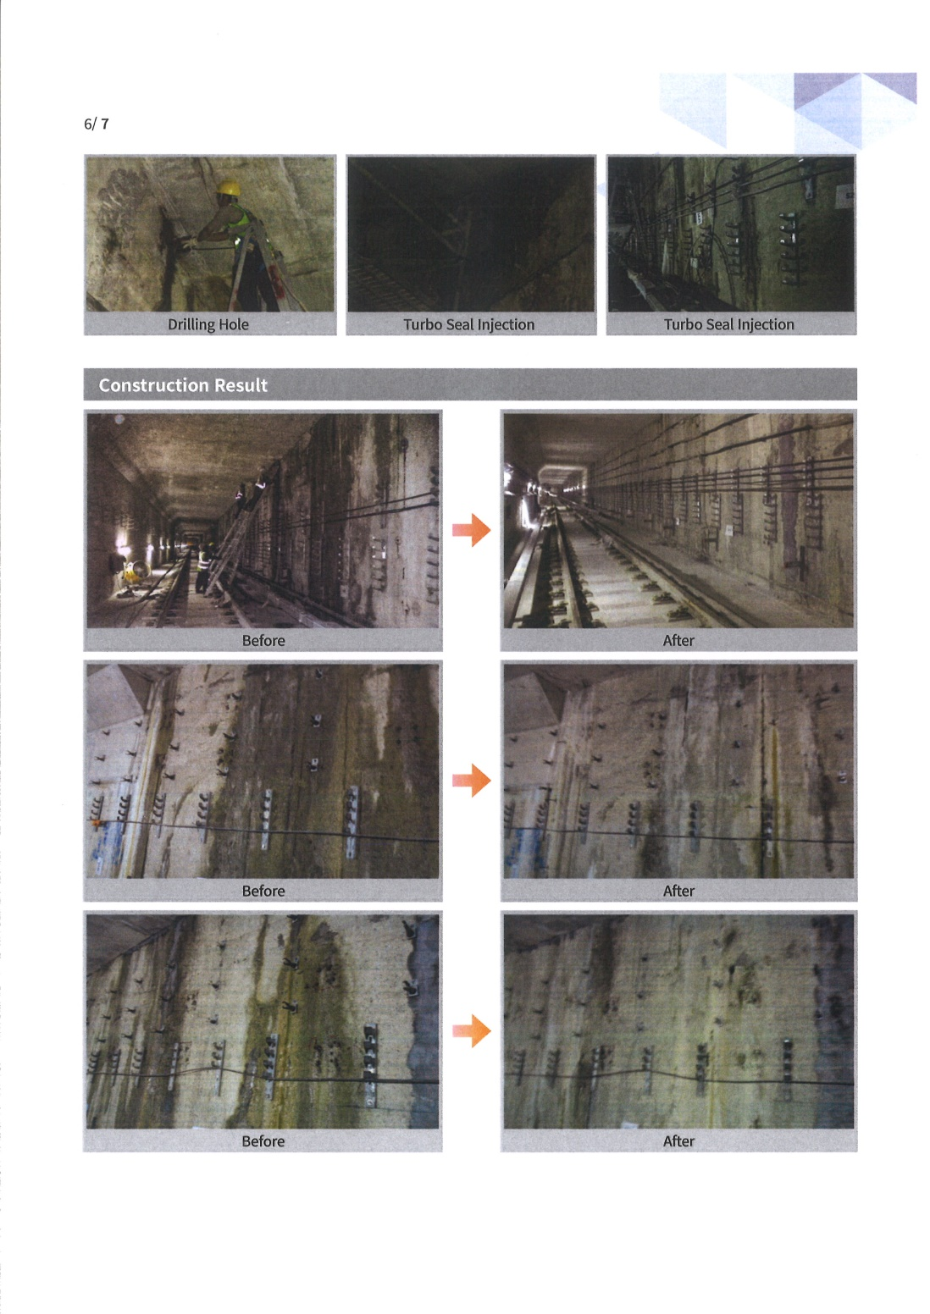

Slide 17
Case Study II
分體冷氣過牆喉
消防水缸防漏工程

Slide 18
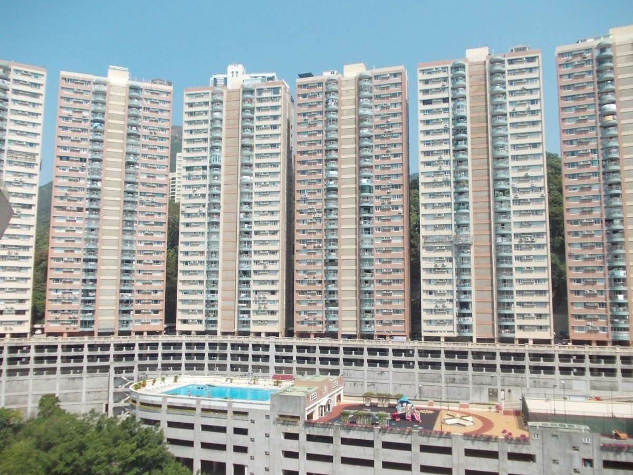
分體冷氣過牆喉防漏工程
工程地點
Job Location
香港薄扶林
域多利道 550號
碧瑤灣
Baguio Villa,
550 Victoria Road,
Pok Fu Lam,
Hong Kong.

Slide 19
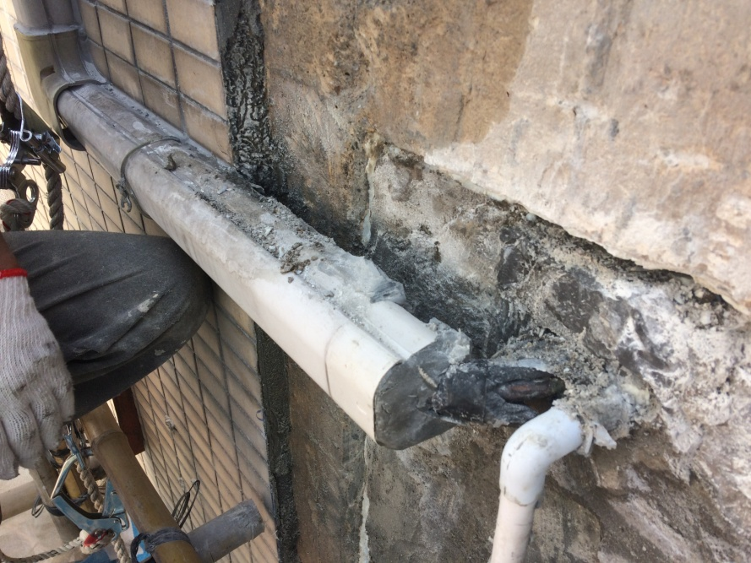
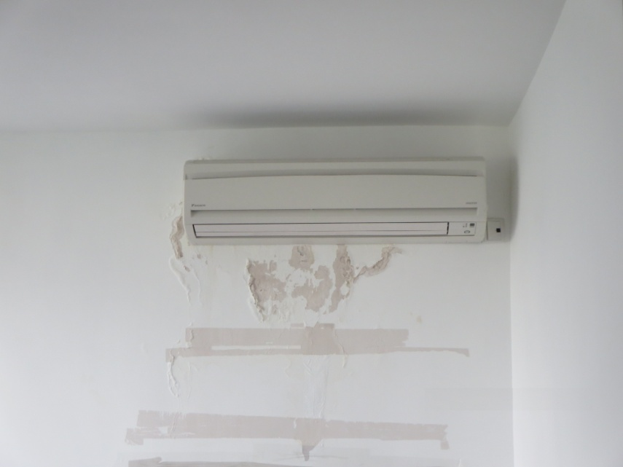
分體冷氣過牆喉防漏工程
施工前情況
Condition Before The Works
雨水經冷氣過牆喉引入室內,導致室內牆身出現滲水現象。
Water seepage was found caused by rainwater seep to internal wall through the air conditioning pipes.

Slide 20
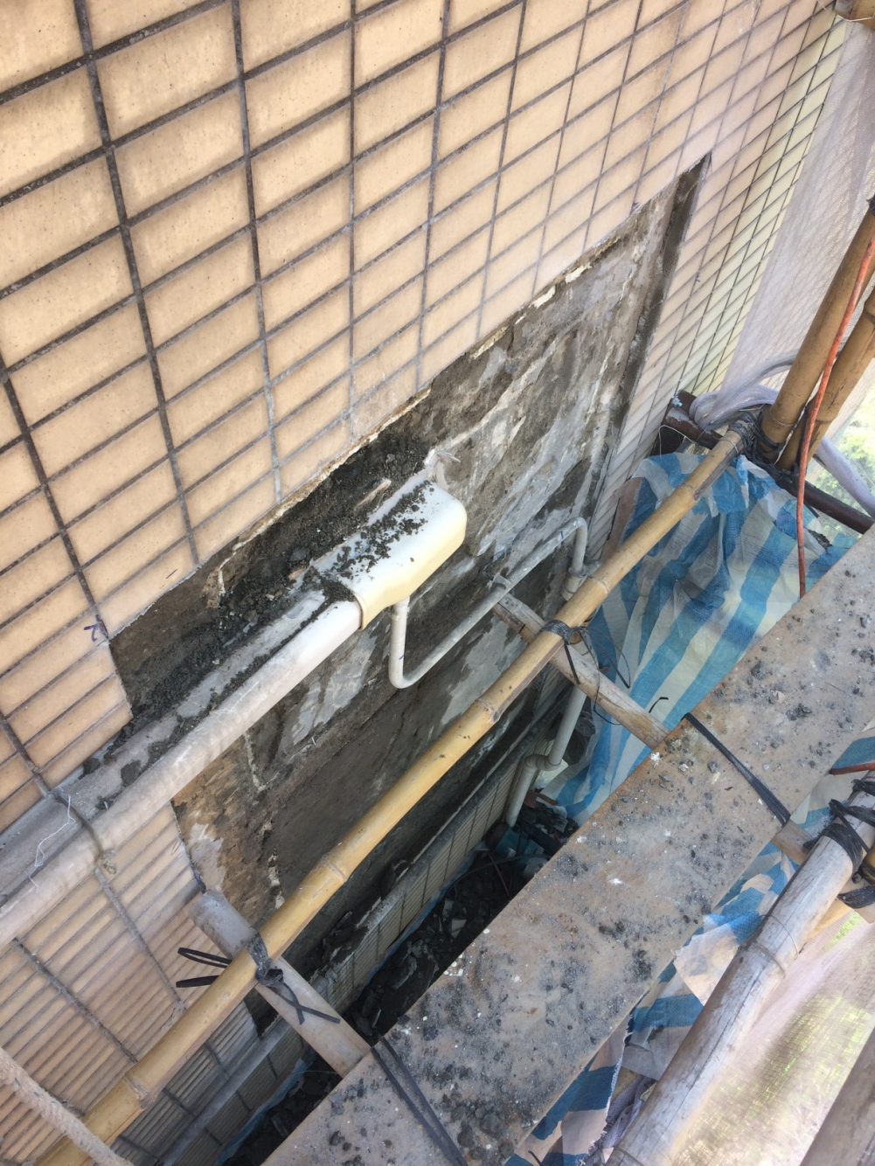
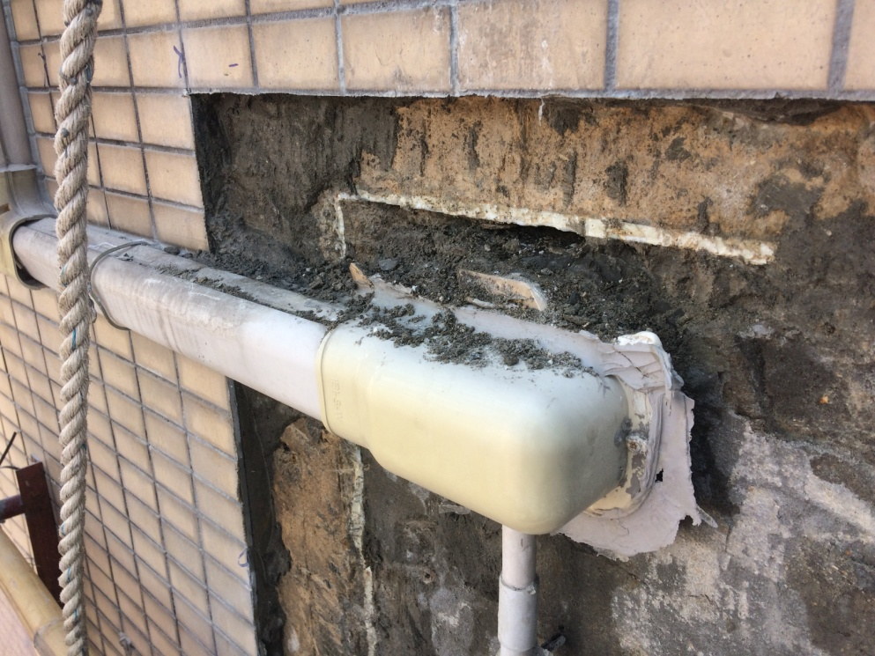
分體冷氣過牆喉防漏工程
施工前情況
Condition Before The Works

Slide 21
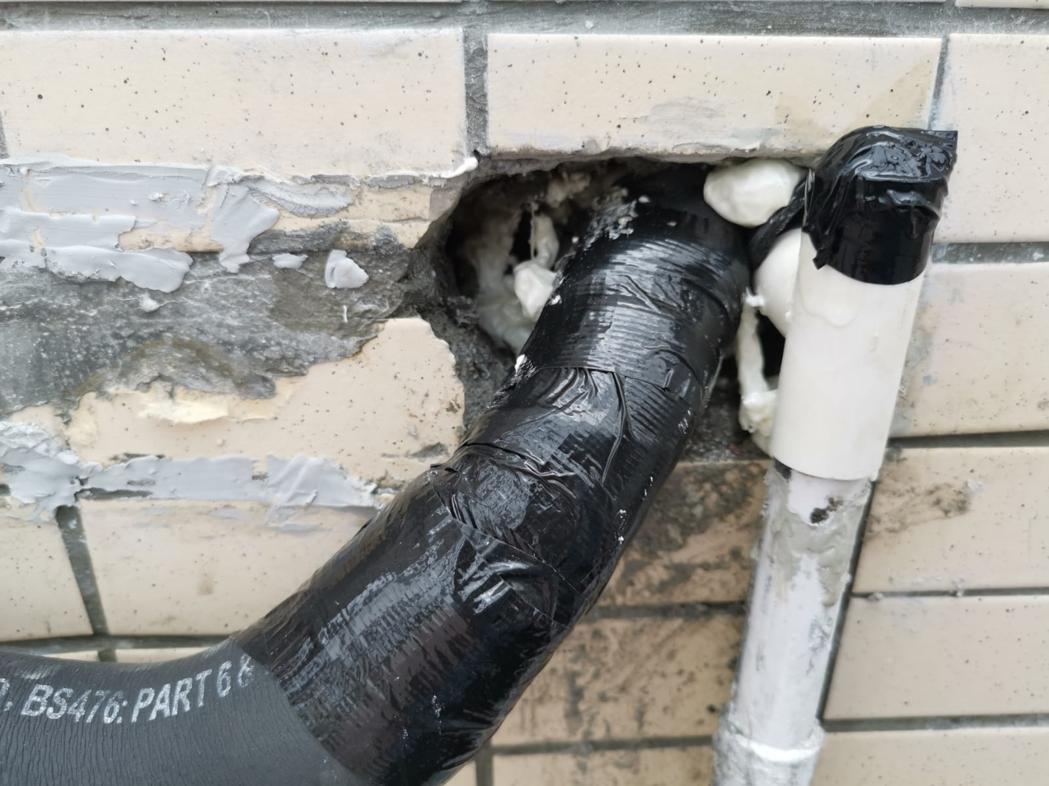
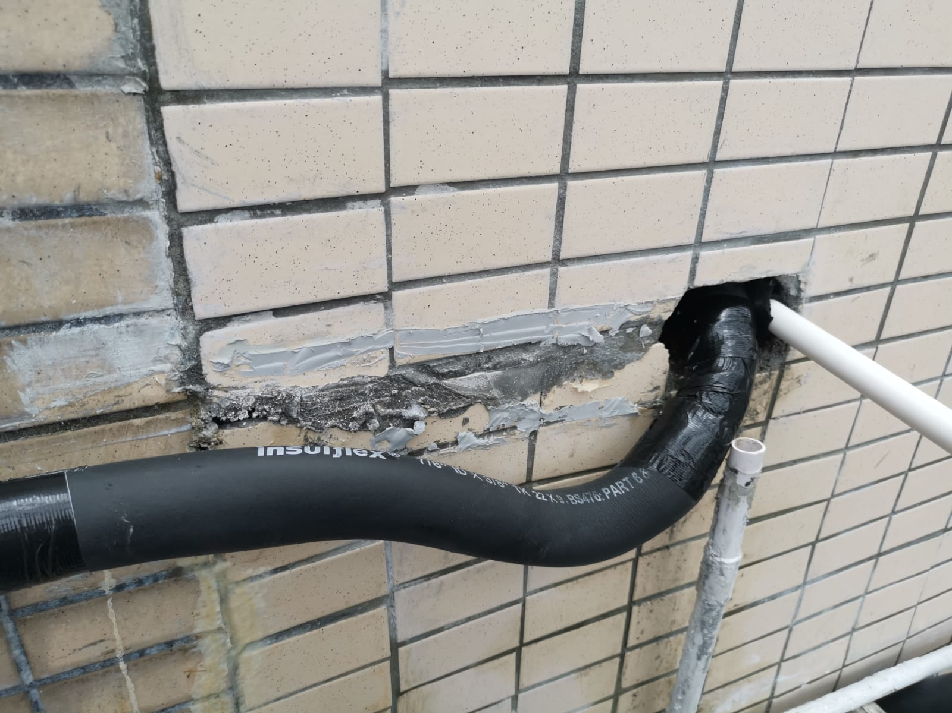
分體冷氣過牆喉防漏工程
施工程序 (1)
Working Procedure (1)
將冷氣過牆喉入室內的方向由上至下,改為由下至上,避免雨水輕易經冷氣過牆喉引入室內。
Rectify the direction of air conditioning pipes through the wall from top to bottom changed to from bottom to top for preventing the rainwater seep to internal wall.

Slide 22
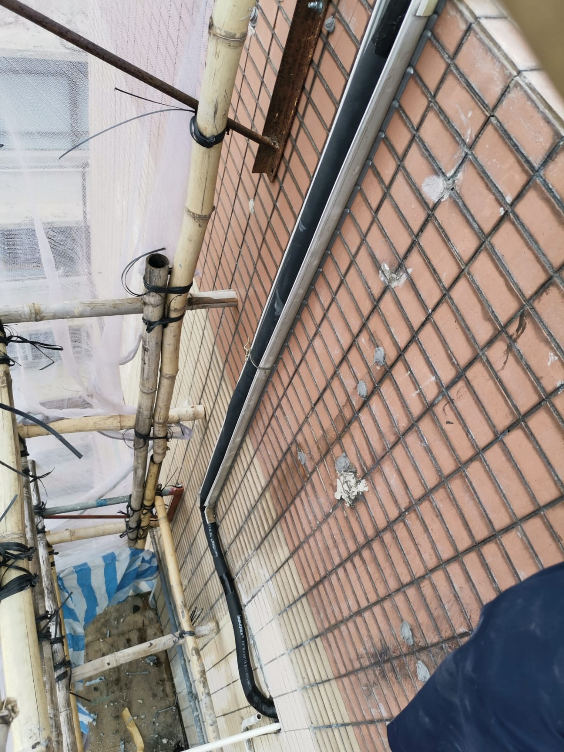
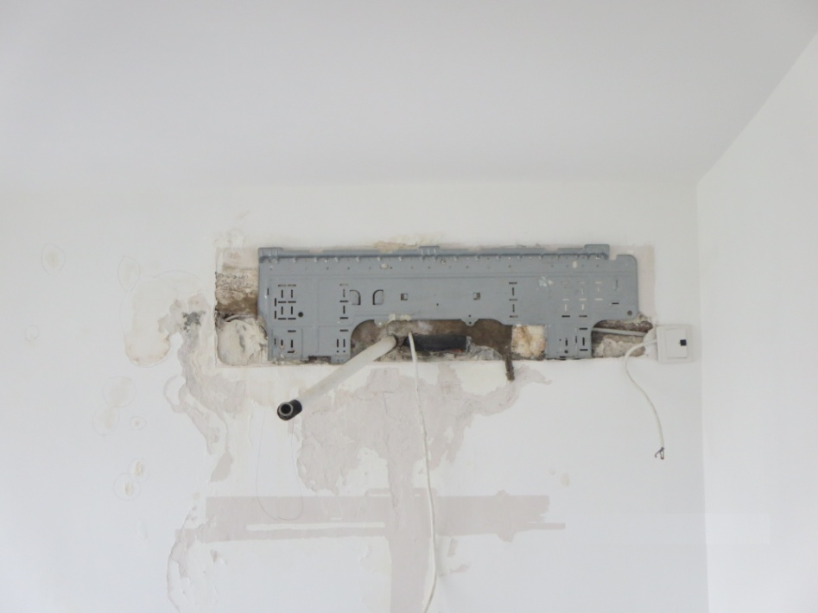
分體冷氣過牆喉防漏工程
施工程序 (1)
Working Procedure (1)

Slide 23
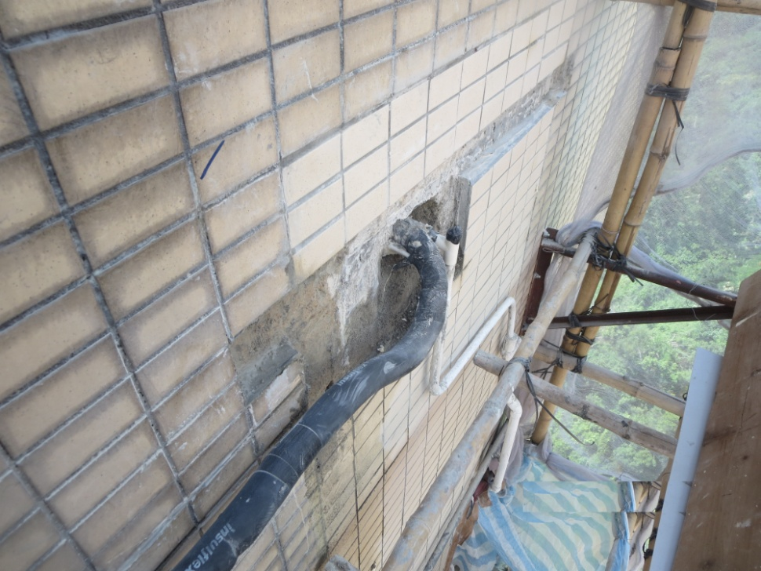
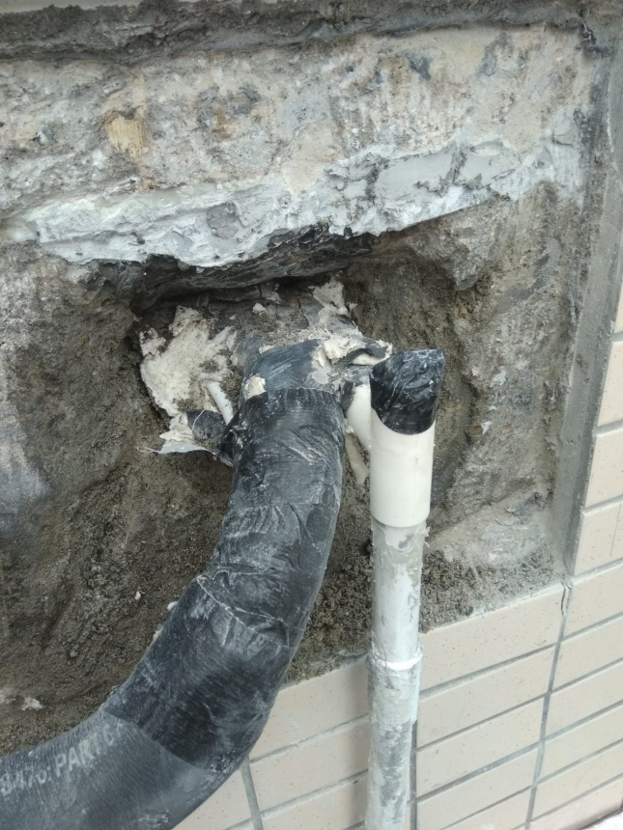
分體冷氣過牆喉防漏工程
施工程序 (2)
Working Procedure (2)
鑿起及清走冷氣過牆喉周邊的水泥填充物。
Remove and cart away the existing cementitious grouting around the air conditioning pipes.

Slide 24
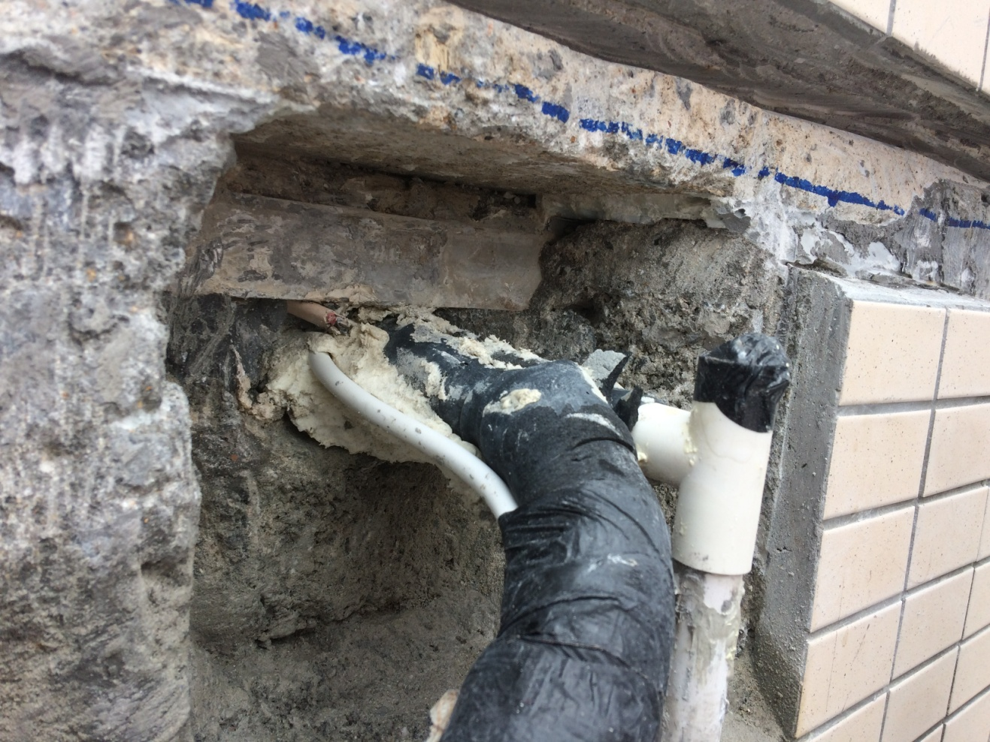
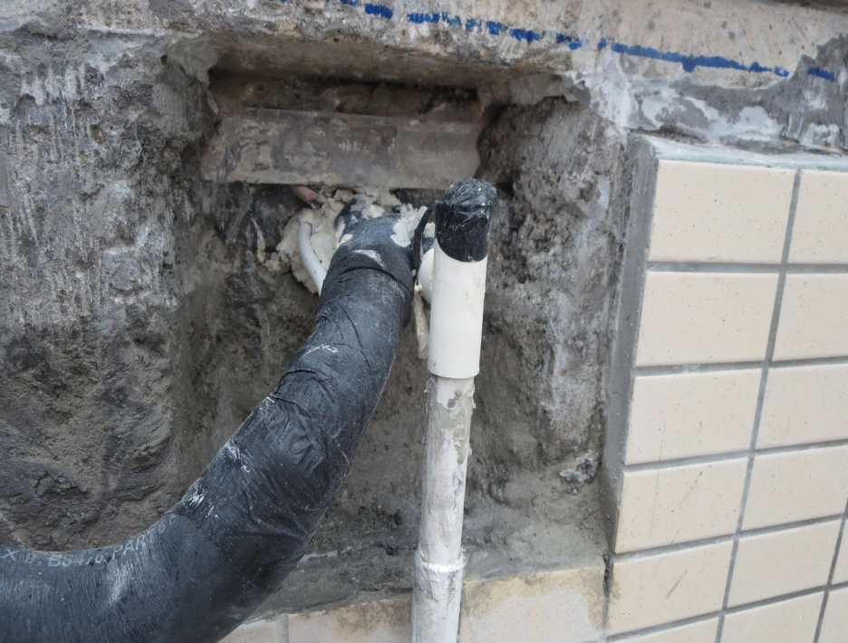
分體冷氣過牆喉防漏工程
施工程序 (2)
Working Procedure (2)

Slide 25
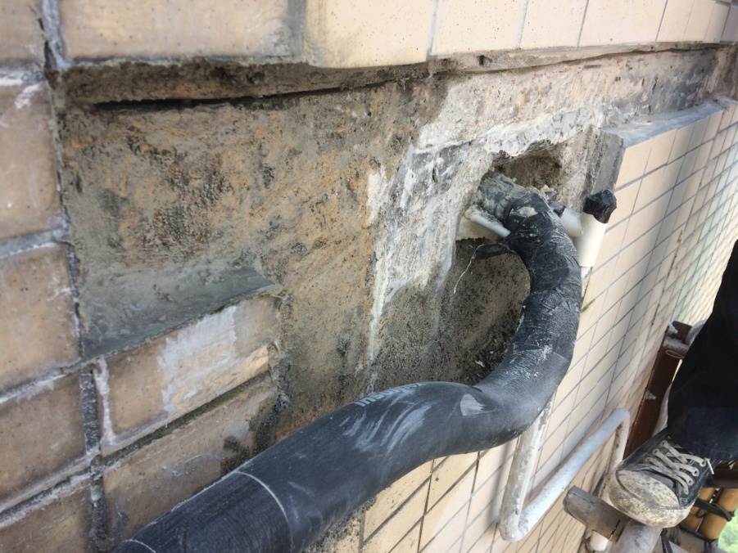
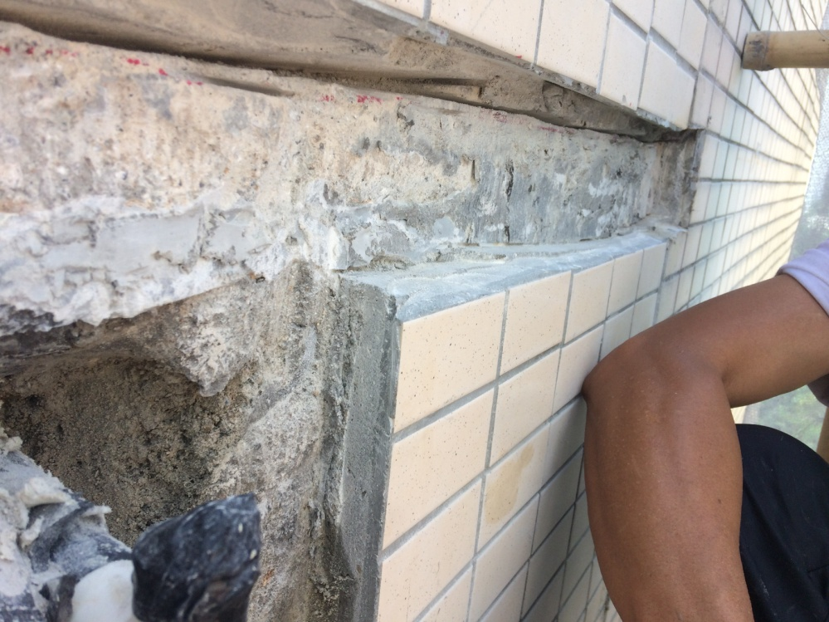
分體冷氣過牆喉防漏工程
施工程序 (3)
Working Procedure (3)
在已鑿開及暴露的石屎外牆頂部位置鎅一條約75毫米深的凹坑。
Saw cut a groove at approx. 75mm deep on top of the exposed concrete external wall.

Slide 26
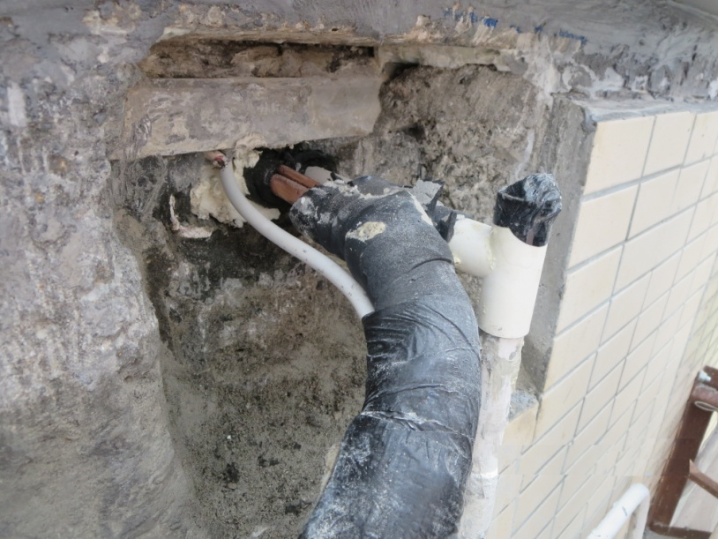
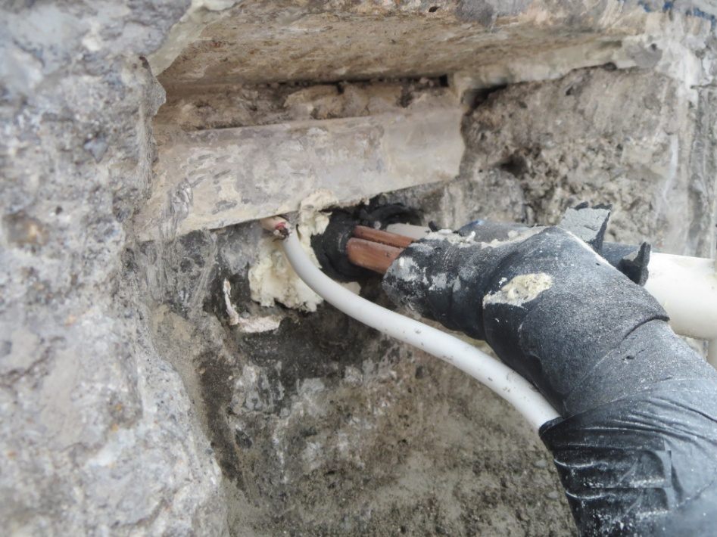
分體冷氣過牆喉防漏工程
施工程序 (4)
Working Procedure (4)
鎅開及清走冷氣喉過牆該一段的豬腸膠保溫層,直至露出原有的銅喉。
Remove and cart away the existing elastomeric insulation layer where conceal in the concrete wall until the existing copper pipe are exposed.

Slide 27
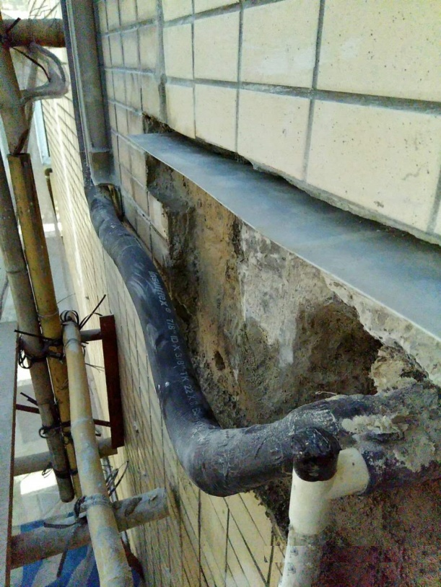
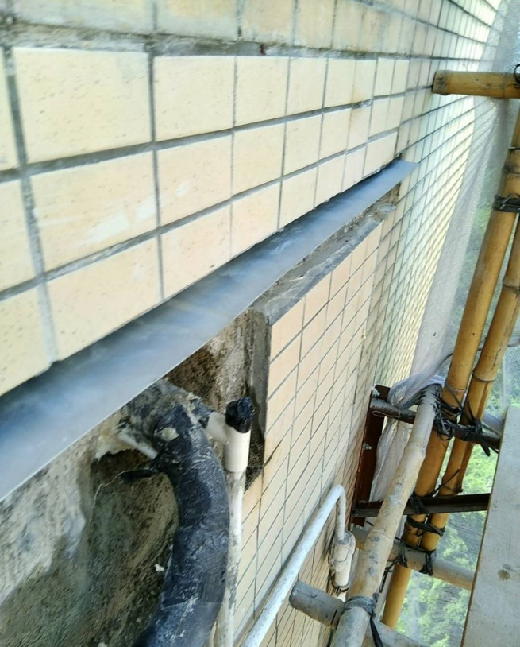
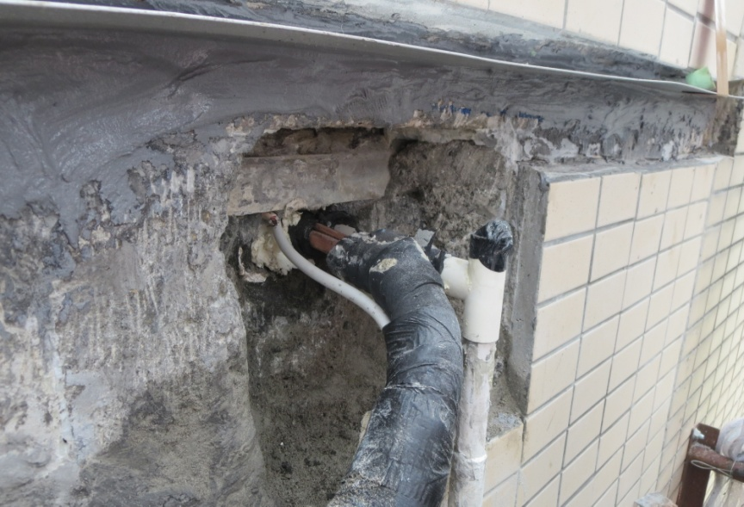
分體冷氣過牆喉防漏工程
施工程序 (5)
Working Procedure (5)
在外牆凹坑內填滿TUFCO Max 500環氧樹脂及安裝鋁片。
Apply TUFCO Max 500 epoxy mortar into the groove and install aluminum plate on external wall.

Slide 28
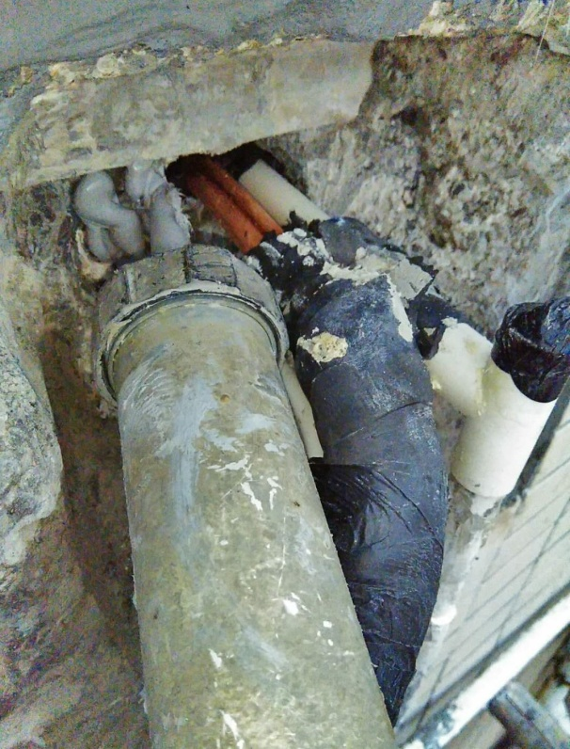
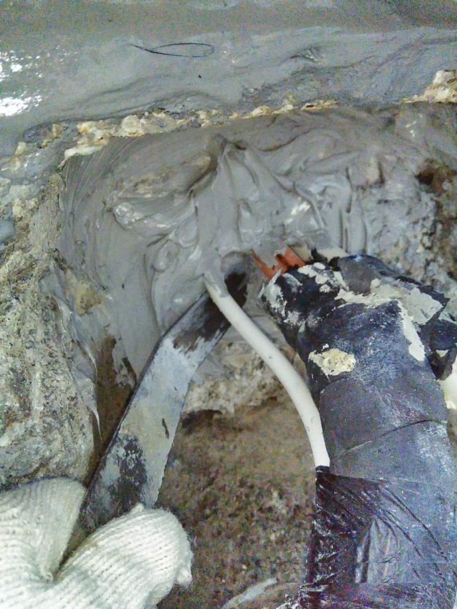
分體冷氣過牆喉防漏工程
施工程序 (6)
Working Procedure (6)
在暴露的位置唧上聚胺脂膠(約50毫米厚)。
Inject polyurethane sealant on the exposed surface at approx. 50mm thick.

Slide 29
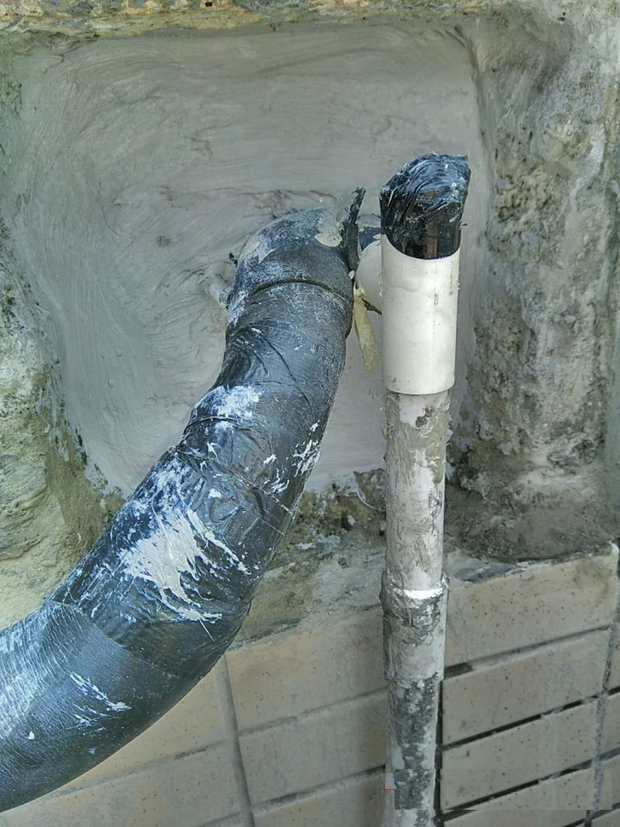
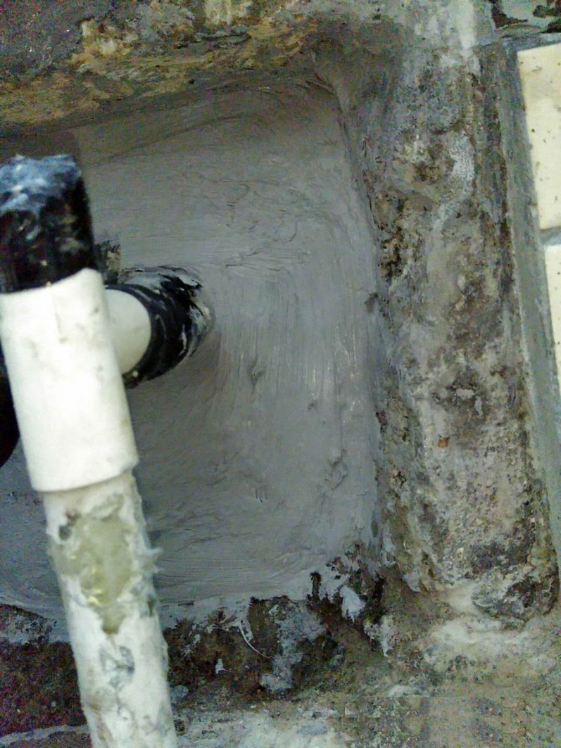
分體冷氣過牆喉防漏工程
施工程序 (6)
Working Procedure (6)

Slide 30
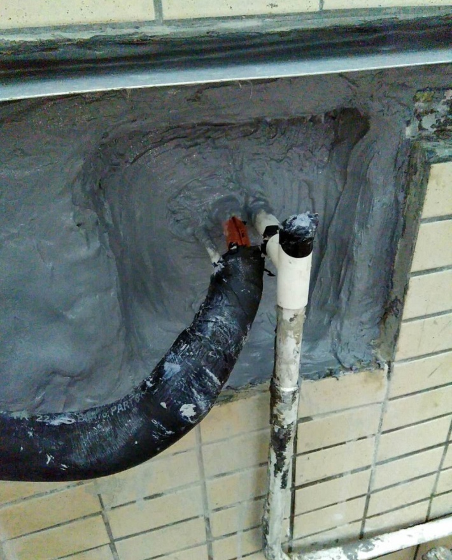
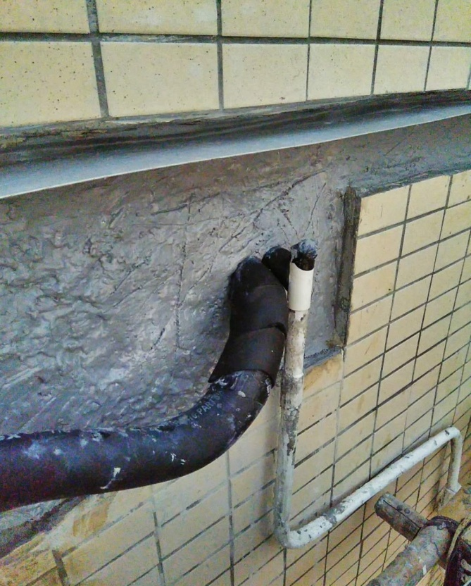
分體冷氣過牆喉防漏工程
施工程序 (7)
Working Procedure (7)
在聚胺脂膠表面批TUFCO Max 500環氧樹脂 (約50毫米厚)。
Apply TUFCO Max 500 epoxy mortar on the surface of the polyurethane sealant at approx. 50mm thick.

Slide 31
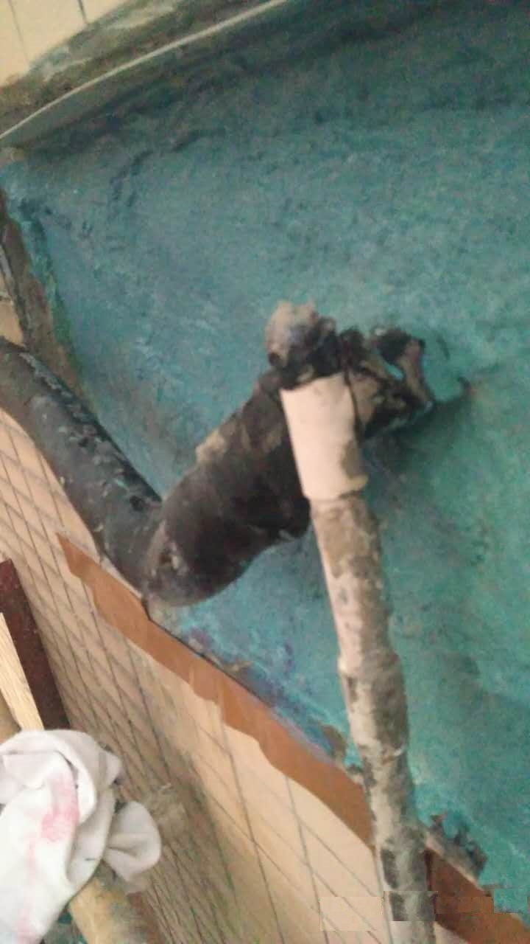
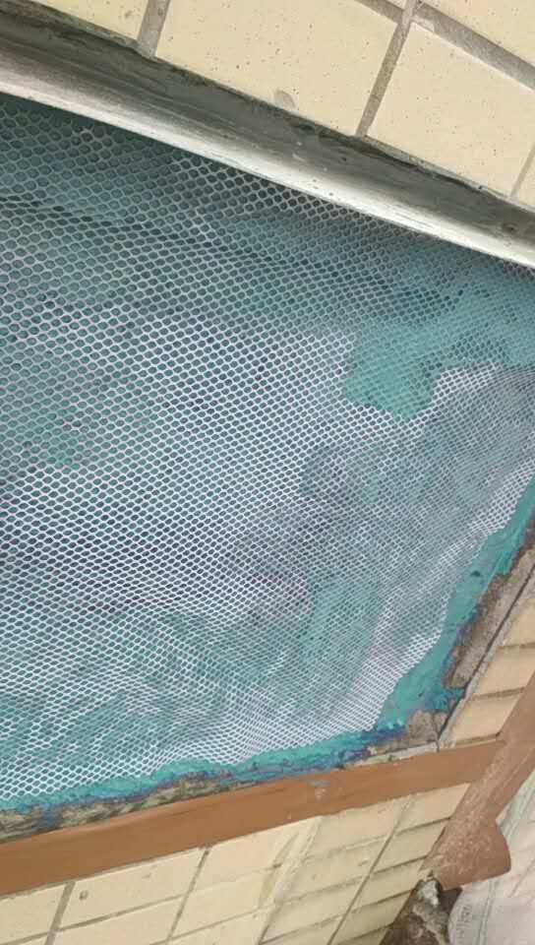
分體冷氣過牆喉防漏工程
施工程序 (8)
Working Procedure (8)
在外牆表面塗上3層LaMaCo Cem Seal NP2英泥基防漏膜,並舖放抗裂聚脂網布。
Apply three coats of LaMaCo Cem Seal NP2 cementitious waterproof membrane on the surface of external wall. Embed polyester fabric into the liquid waterproof membrane.

Slide 32
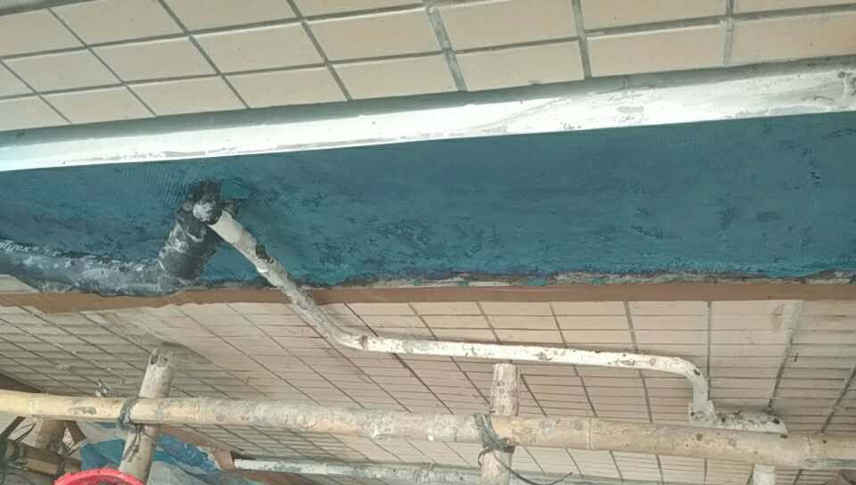
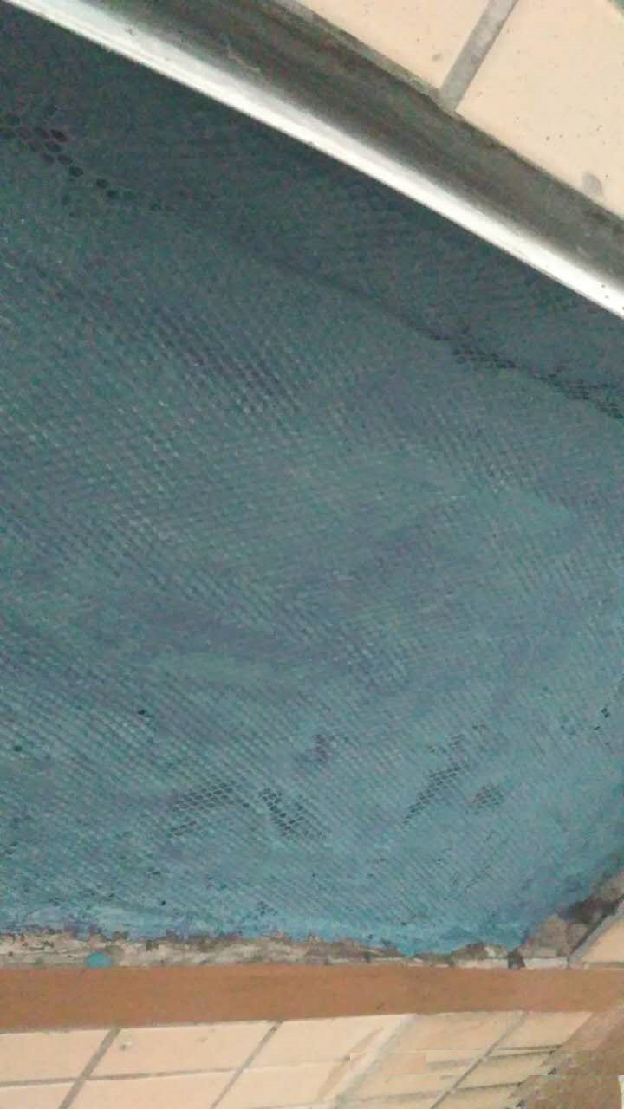
分體冷氣過牆喉防漏工程
施工程序 (8)
Working Procedure (8)

Slide 33
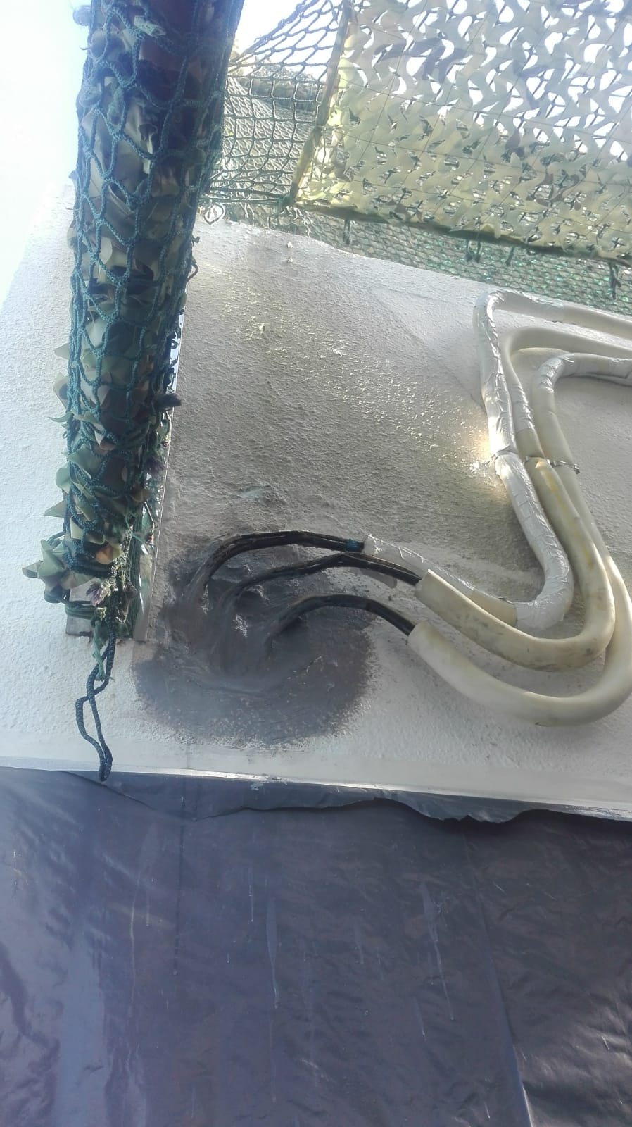
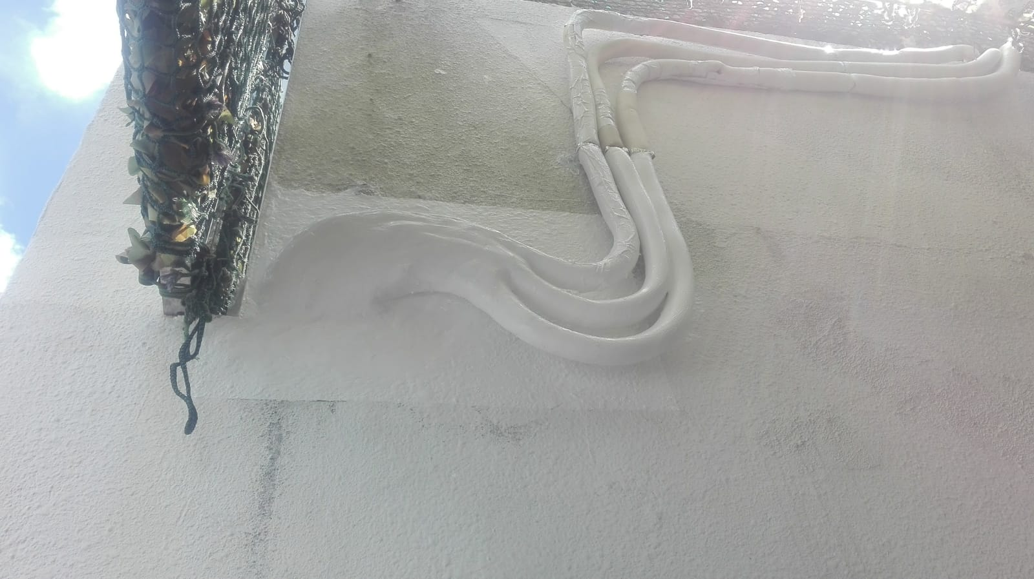
分體冷氣過牆喉防漏工程
其他工程記錄
Other Job Reference
新界西貢銀巒路7號
華富花園
Fullway Garden,
7 Silver Crest Road,
Sai Kung,
New Territories.

Slide 34
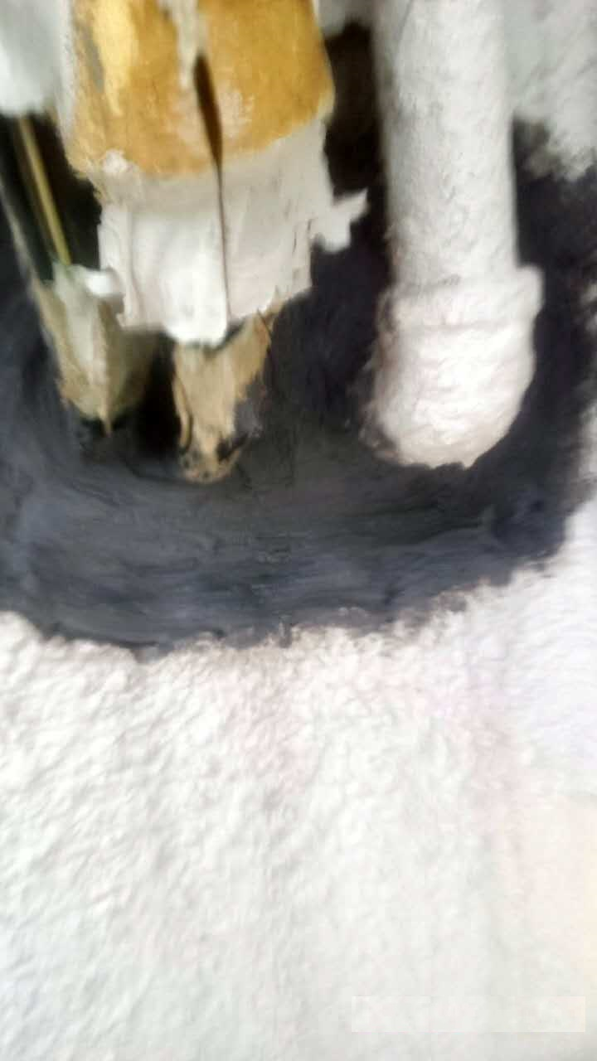
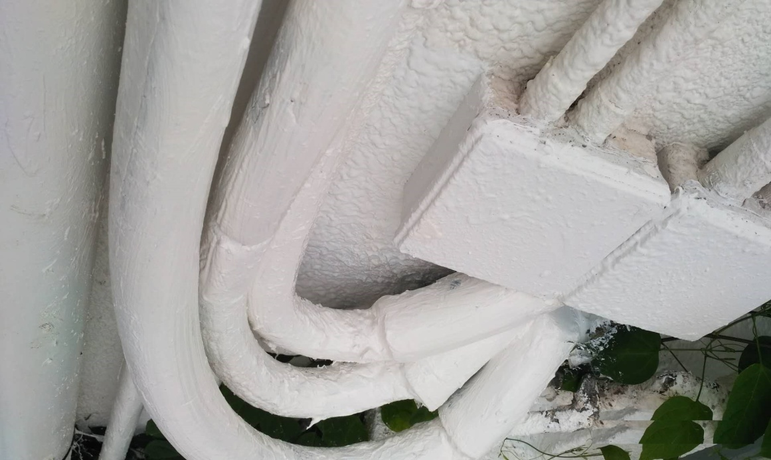
分體冷氣過牆喉防漏工程
其他工程記錄
Other Job Reference
表面塗上防曬面油

Slide 35
消防水缸防漏工程
工程地點
Job Location
九龍旺角彌敦道585號富時中心 4/F 消防水缸
Fire Service Tank at 4/F., Righteous Centre, 585 Nathan Rd, Mong Kok, Kowloon
施工面積
Area
131平方米
131m²
完工日期
Job Completed
2019年5月
May 2019
選用材料
Material Used
Elastan One Part Polyurea PU(A) 1590W
Primer EW

Slide 36
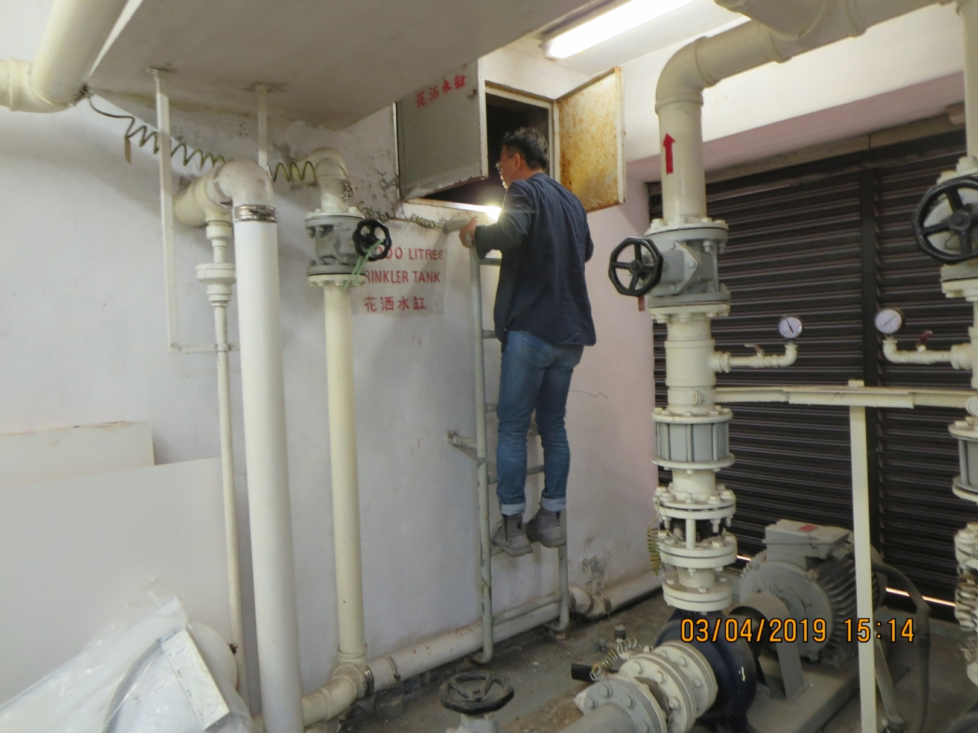
消防水缸防漏工程
施工前水缸內情況
Job Site Condition Before The Works

Slide 37
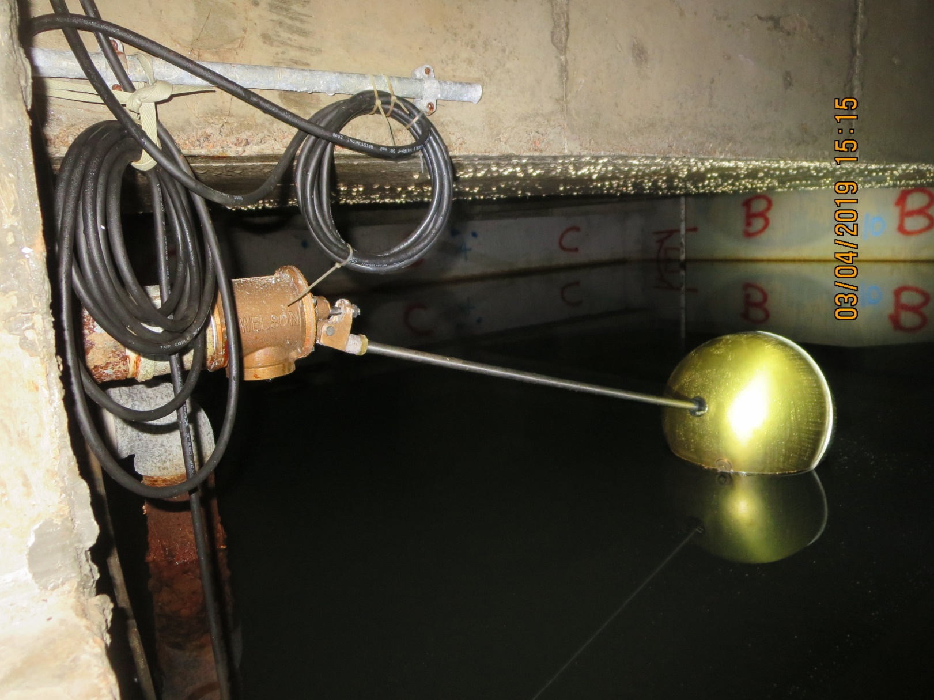
消防水缸防漏工程
施工前水缸內情況
Job Site Condition Before The Works

Slide 38
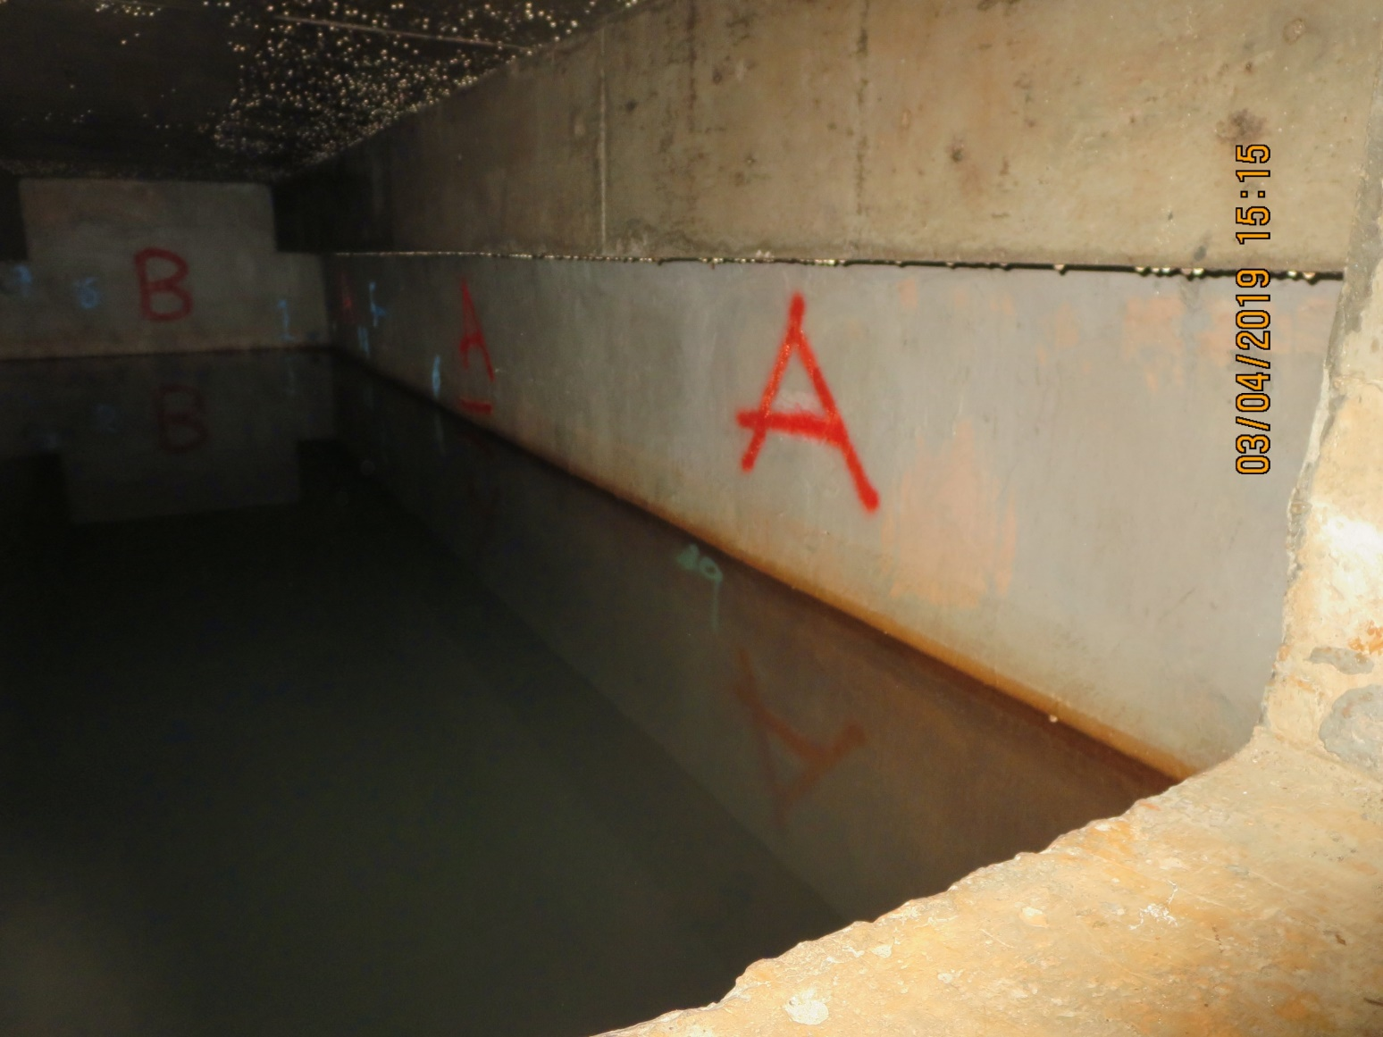
消防水缸防漏工程
施工前水缸內情況
Job Site Condition Before The Works

Slide 39
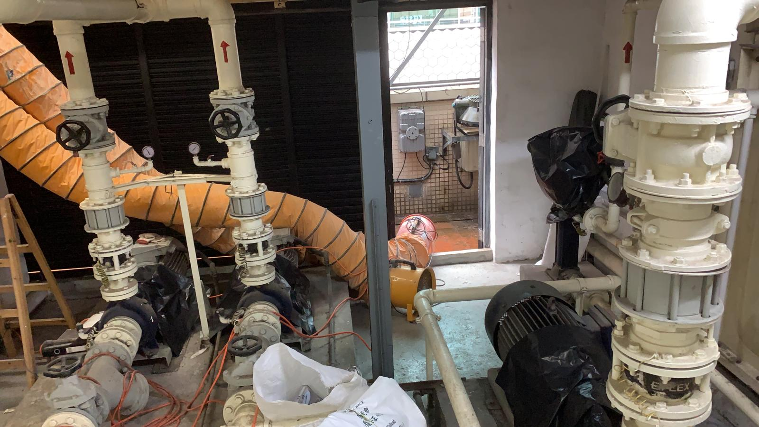
消防水缸防漏工程
施工程序 (1)
Working Procedure (1)
在水缸內臨時安裝照明及抽氣系統
Temporary installation of lighting and the ventilation system in water tank

Slide 40

消防水缸防漏工程
施工程序 (2)
Working Procedure (2)
鑿起及清走水缸內四邊牆身及底部之鬆散英泥沙層，直至石屎層。
Remove and cart away the loose / deteriorated cement sand to expose the concrete layer.

Slide 41

消防水缸防漏工程
施工程序 (2)
Working Procedure (2)

Slide 42

消防水缸防漏工程
施工程序 (3)
Working Procedure (3)
使用打磨機械徹底打磨施工基面，以加強材料與基面之黏合力。
Grinding to the wall surface to remove the powdery layer and dirty layer.

Slide 43



消防水缸防漏工程
施工程序 (3)
Working Procedure (3)

Slide 44

消防水缸防漏工程
施工程序 (4)
Working Procedure (4)
選用MasterEmaco P 157防水膠漿混合英泥沙在所有牆腳位置批上一條Angle Fillet。
Construct 25 X 25mm angle fillet with cementitious mortar mix with MasterEmaco P 157 bonding agent.

Slide 45


消防水缸防漏工程
施工程序 (4)
Working Procedure (4)

Slide 46

消防水缸防漏工程
施工程序 (5)
Working Procedure (5)
選用BASF MasterEmaco P157防水膠漿混合英泥沙批平打鑿後之位置。
Apply cement sand mix with MasterEmaco P157 bonding agent and allow to become tacky.

Slide 47


消防水缸防漏工程
施工程序 (5)
Working Procedure (5)

Slide 48

消防水缸防漏工程
施工程序 (6)
Working Procedure (6)
在出入水管周邊位置鎅鑿V-cut，然後用TUFCO Max 500環氧樹脂修補。
V-cut along the pipe and repair / make good with MAX 500 epoxy mortar

Slide 49

消防水缸防漏工程
施工程序 (7)
Working Procedure (7)
在處理好之表面塗上一層Primer EW防水底油。
Apply one coat of Primer EW on the well prepared surface.

Slide 50



消防水缸防漏工程
施工程序 (7)
Working Procedure (7)

Slide 51

消防水缸防漏工程
施工程序 (8)
Working Procedure (8)
塗上二層Elastan One-Part Polyurea PU(A) 1590W彈性無縫防漏膜，同時加入抗裂聚脂網。
Hand apply the two coat of Elastan One-Part Polyurea PU(A) 1590W waterproofing coating. Embed polyester fabric into the liquid Polyurea.

Slide 52


消防水缸防漏工程
施工程序 (8)
Working Procedure (8)

Slide 53

消防水缸防漏工程
施工程序 (9)
Working Procedure (9)
待第二層PU(A) 1590W彈性無縫防漏膜乾透後，塗上第三層PU(A) 1590W彈性無縫防漏膜。
Hand apply the finish coat of Elastan One-Part Polyurea PU(A) 1590W waterproofing coating.

Slide 54


消防水缸防漏工程
施工程序 (9)
Working Procedure (9)

Slide 55

消防水缸防漏工程
施工後水缸內之情況
Job Site Condition After The Works

Slide 56


消防水缸防漏工程
施工後水缸內之情況
Job Site Condition After The Works

Slide 57


消防水缸防漏工程
施工後水缸內之情況
Job Site Condition After The Works

Slide 58







Common Water Seepage Problems
Lift Pit & Sump Pumps
NCPP Technologies
IWM Nano-Waterproofing System vs. Water Seepage Problem in Buildings

Slide 59






Common Water Seepage Problems
Water Tank & AC Rooms
NCPP Technologies
IWM Nano-Waterproofing System vs. Water Seepage Problem in Buildings

Slide 60




Common Water Seepage Problems
Basement Waterproofing & Deteriorated Concrete Restoration
Before
After
NCPP Technologies
IWM Nano-Waterproofing System vs. Water Seepage Problem in Basement

Slide 61



Case Study -
Failure Manhole Movement Joint & Deteriorated Concrete Rejuvenated by IWM System
Hong Kong International Airport
Midfield Concourse -APM Tunnel
Water Leak (Movie)
NCPP Technologies
IWM Nano-Waterproofing System vs. Water Seepage Problem in Failed MJ

Slide 62





Case Study
Deteriorated Concrete – High Pressure Grout Injection
Water Leak (Movie)
NCPP Technologies
IWM Nano-Waterproofing System vs. Water Seepage Problem in Basement

Slide 63


NCPP Technologies

Slide 64

Mechanism of Concrete Cracking
NCPP Technologies

Slide 65





Mechanism of Concrete Cracking
  Corrosion of Reinforcement
  Oxidation
  2. Chemical Attack
  Carbonation
  Chloride Attack
  Sulphate Attack
  Acid Attack
  Alkali-Silica Reaction (ASR)
NCPP Technologies

Slide 66







Failure Mode of Conventional Waterproofing Membranes System
NCPP Technologies

Slide 67
“IWM” Integrated Waterproofing Membrane System
How Does Its Work?
NCPP Technologies

Slide 68




NCPP “IWM” Integrated Waterproofing Membrane System
CanSEALER – Negative Water Pressure Test
Concrete Coring
(Tests witnessed by HyD HKSAR and conducted in HK HOKLAS Laboratory)
NCPP Technologies

Slide 69








NCPP “IWM” Integrated Waterproofing Membrane System
CanSEALER – Penetrative Ability
Penetration Test (EN 13501-1)
C30-C35 (40 mm)
Laboratory Certified
UNI EN ISO 9001: 2000
NCPP Technologies

Slide 70

“IWM” Integrated Waterproofing Membrane System
How Does Its Work?
NCPP Technologies

Slide 71


Key Components for
IWM-OMC Neutralization Bonding Techniques
CanSEALER
CanCEMENT
CanFILM
CleanEASE
Manufacturer
CanaShield Nano-Technologies Inc.
Richmond. B.C. Canada
Web : www.canashield .com
Technical Representative
CanaShield Nano-Technologies Limited
Address: Flat B, 19/F, Manly Comm Bldg.,
15 Soy Street, Mongkok, Kowloon, HK
Authorised Applicator
GreenWalls Bioengineering (HK) Limited
Web : www.greenwalls.com.hk
Email : info@greenwalls.com.hk

Slide 72


How NCPP Technologies optimise/deal with the traditional RC concrete repairing's weaknesses
NCPP工法如何優化/處理傳統修復工法的不足
 | Fill up/patch up void 填補/修補空隙 | High pressure injection grout 高壓注漿
Weaknesses 修復工法的不足 | Cold joint effect 冷縫效應 Delamination 離層剝落 | Build in Pressure increase internal stress 內部壓力因高壓注漿而增加
How NCPP Technologies optimise/deal with it NCPP工法如何優化/處理 | OMC method make use of molecular bond to bond the existing concrete and newly patches 通過分子鍵將新舊混凝土結合成為一體 | Non destructive low pressure method 非打拆式低壓施工法

